Slide 1
Retrieving the most representative movie actor for a given Query
By classifying movie scripts based on an AI text emotions classifier

Slide 2
Table of contents
01
02
03
05
Data Collection
Classifying the movie scripts
Vector Space Model
04
Exposing the functions
Evaluation

Slide 3
01
Data collection
IMDb and IMSDb

Slide 4

Source - IMDb
Describe about how you collected the data
Describe how the data was stored

Slide 5

Source - IMSDb
Describe about how you collected the data
Describe how the data was stored

Slide 6
56.000
Actors in the Database

Slide 7
270.000
Scripts in the Database

Slide 8
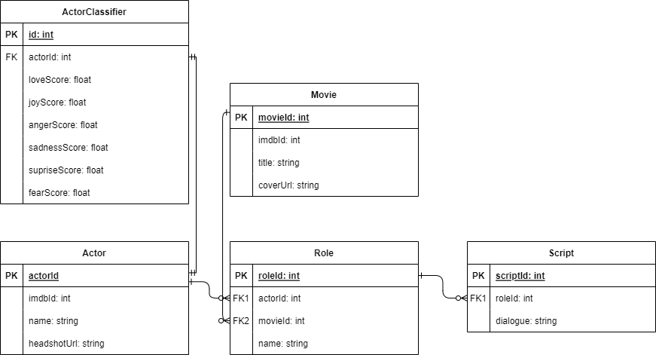
ER-Diagram
Following relations exists in our database:

Slide 9
02
Classifying the movie scripts
Based on AI classifier

Slide 10
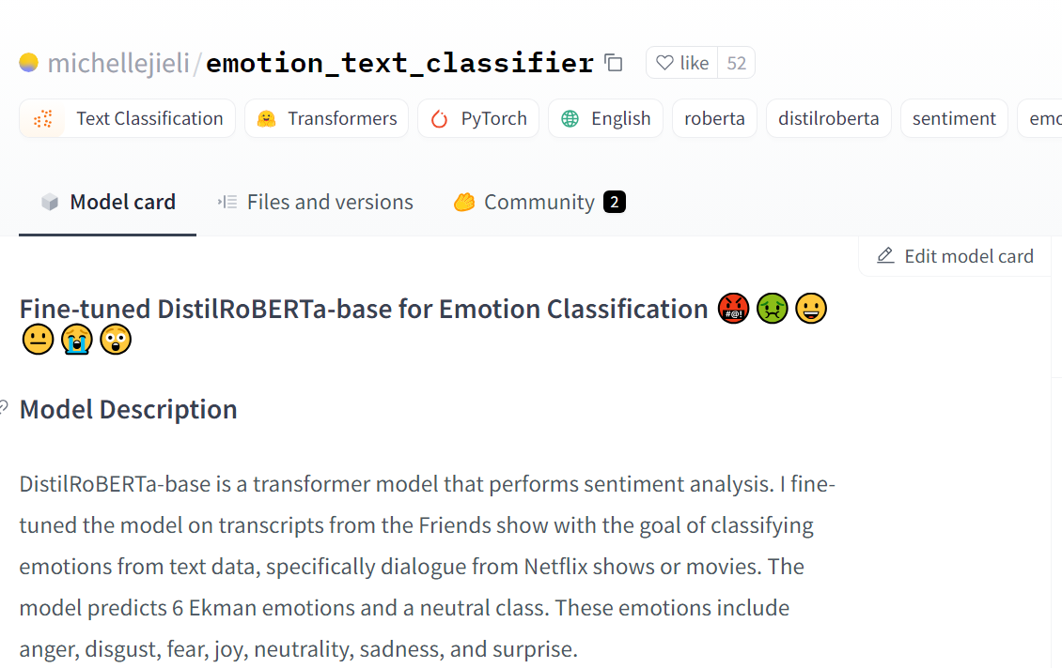
AI model
We used the following AI model to classify the scripts

Slide 11
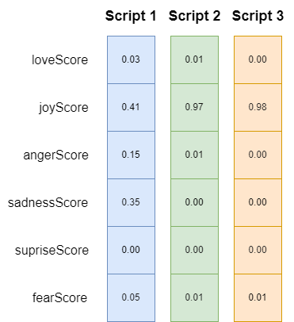
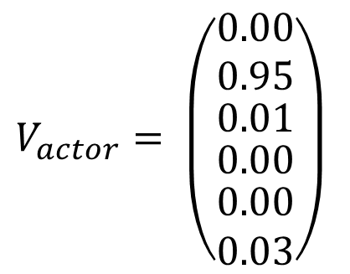
Classifying the scripts
E.g.: Ryan Gosling in „Fracture“
$$V_{actor}= \left(\begin{matrix}0.00 \\ 0.95 \\ \begin{matrix}0.01 \\ \begin{matrix}0.00 \\ \begin{matrix}0.00 \\ 0.03\end{matrix}\end{matrix}\end{matrix}\end{matrix}\right)$$

Slide 12
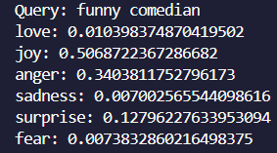
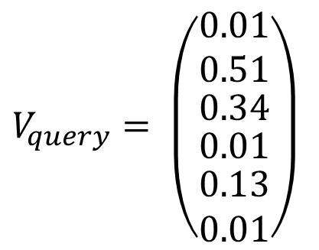
Classifying the Query
Describe how we classified the Query
$$V_{query}= \left(\begin{matrix}0.01 \\ 0.51 \\ \begin{matrix}0.34 \\ \begin{matrix}0.01 \\ \begin{matrix}0.13 \\ 0.01\end{matrix}\end{matrix}\end{matrix}\end{matrix}\right)$$

Slide 13
03
Implementation of the IR System
Vector Space and Boolean Model

Slide 14
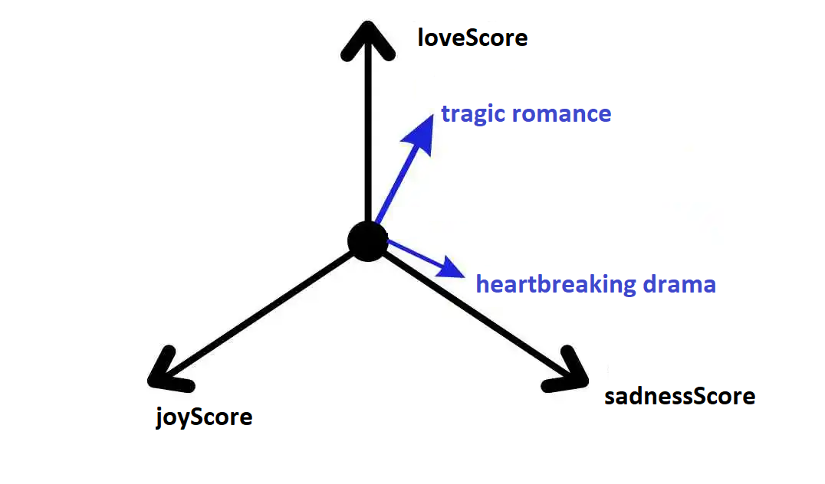
Vector Space Model (VSM)

Slide 15
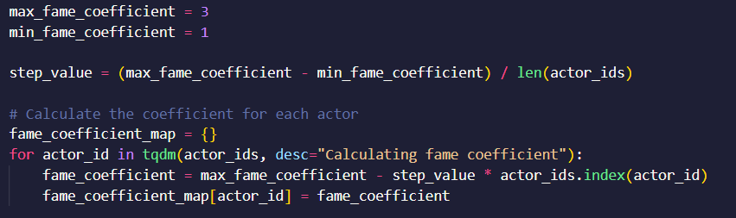
Vector Space Model – Fame Coefficient
Actors with only one line of script could have a really high classification
User Need => rather famous actors
Implementation of a new fame coefficient
Notes:
the date coefficient, a real-valued non-zero value which is proportional to the publishing date

Slide 16
Problems during the Implementation
Mapping of the actors to their according script
Classifying the scripts
Figuring out the right coefficients
Missing scripts e.g. Henry Cavill has no scripts
Notes:
, was a recurring problem sometimes to keep track of documents and terms and their relation to each other
During the handling of big datasets it is important to keep the time complexity in mind.

Slide 17
04
Exposing the Functions
FastAPI, UI, Deployment

Slide 18

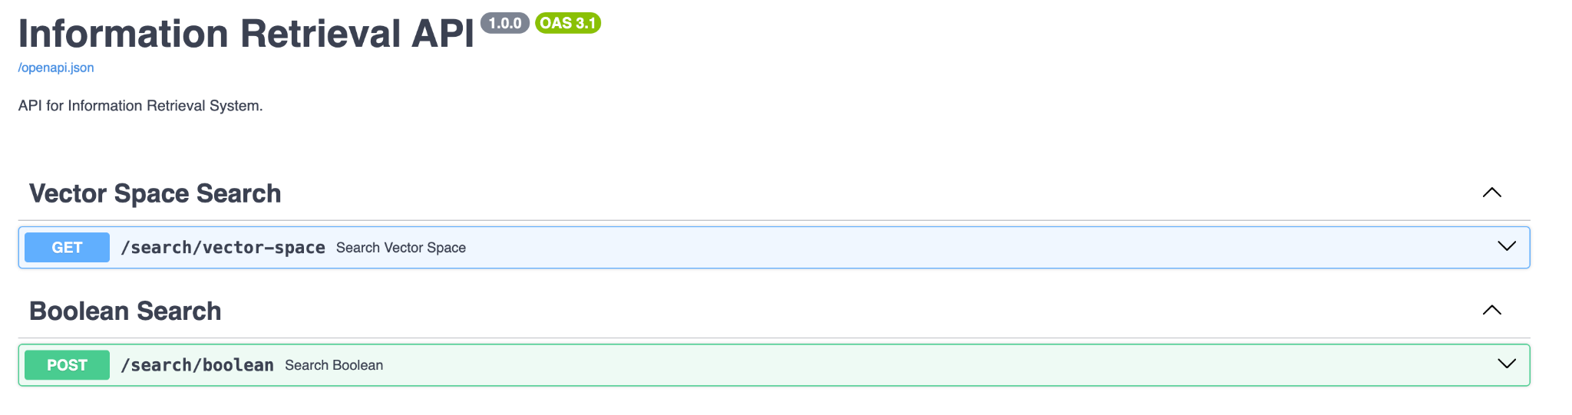
FastAPI
Implemented HTTP endpoints for both models

Slide 19



User Interface
Implemented User Interface with Next.js and NextUI

Slide 20
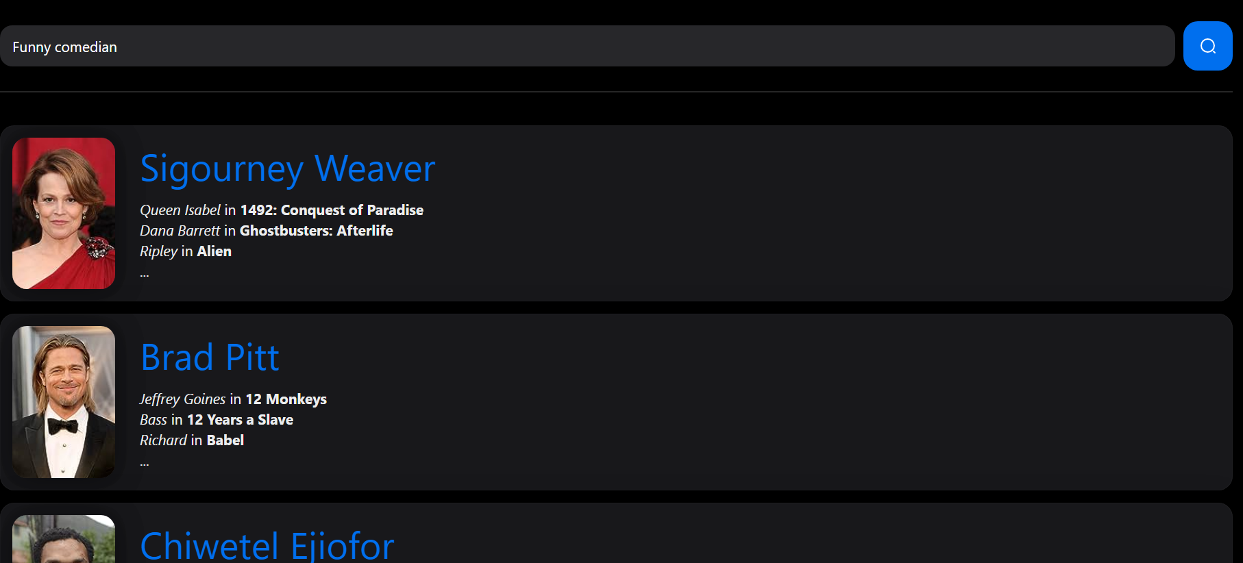
User Interface

Slide 21

Azure Deployment
entire application, including search functionalities and the web interface, is deployed on Microsoft Azure App Service to make it available to everyone.
UI: https://app-movieactorranking-prod.azurewebsites.net/
API: https://api-movieactorranking-prod.azurewebsites.net/

Slide 22
Demo
*show demo of model, nochmal besprechen*

Slide 23
05
Evaluation
Precision, Recall, F1

Slide 24
queries for evaluation
No. | Query
1 | romantic scenes
2 | action filled dramas
3 | funniest actors ever
4 | heartbreaking roles
5 | saddest movie performances
6 | action-packed movie stars

Slide 25
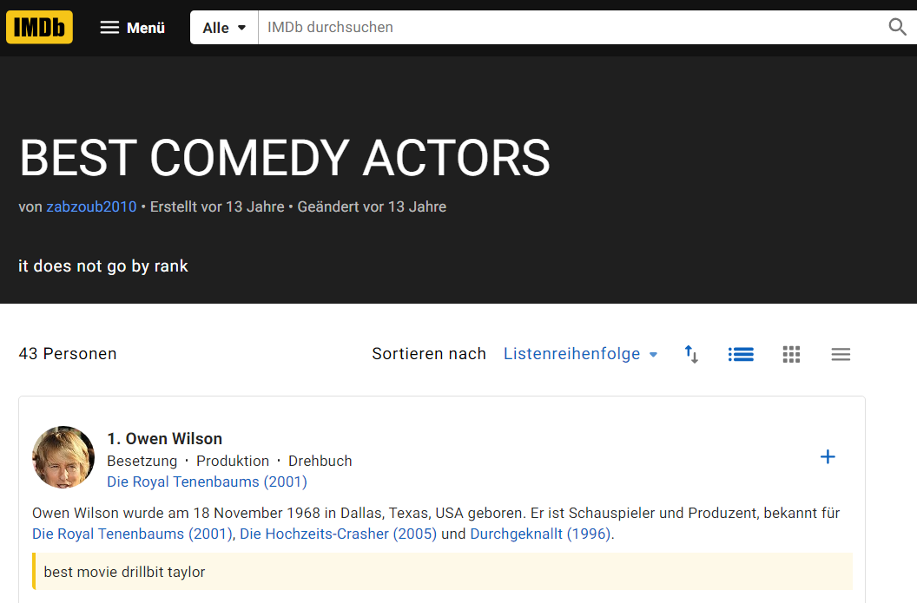
Build ground truth
We got online rankings for the best actors for a given Query:

Slide 26
Recall, precision, f1
Insert new evaluation

Slide 27
Recall, precision, f1
Insert new evaluation
Recall:

Slide 28
Recall, precision, f1
Insert new evaluation
Precision:

Slide 29
Recall, precision, f1
Insert new evaluation
F1-Score:

Slide 30
Xxx% - best fame coefficient ratio

Slide 31
Thanks!
Do you have any questions?
Please keep this slide for attribution

